Slide 1
E-LEARNING
TAINGUYEN-MEUMOC
MENTORSHIP_PROGRAM

Slide 2
AGENDA
I. OUTLINE
II. ANALYSIS

Slide 3

I. OUTLINE
1. USE CASE
2. DATABASE

Slide 4
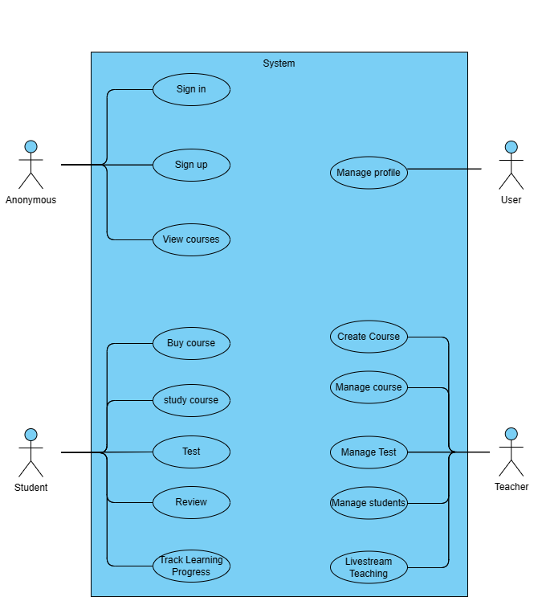

Slide 5
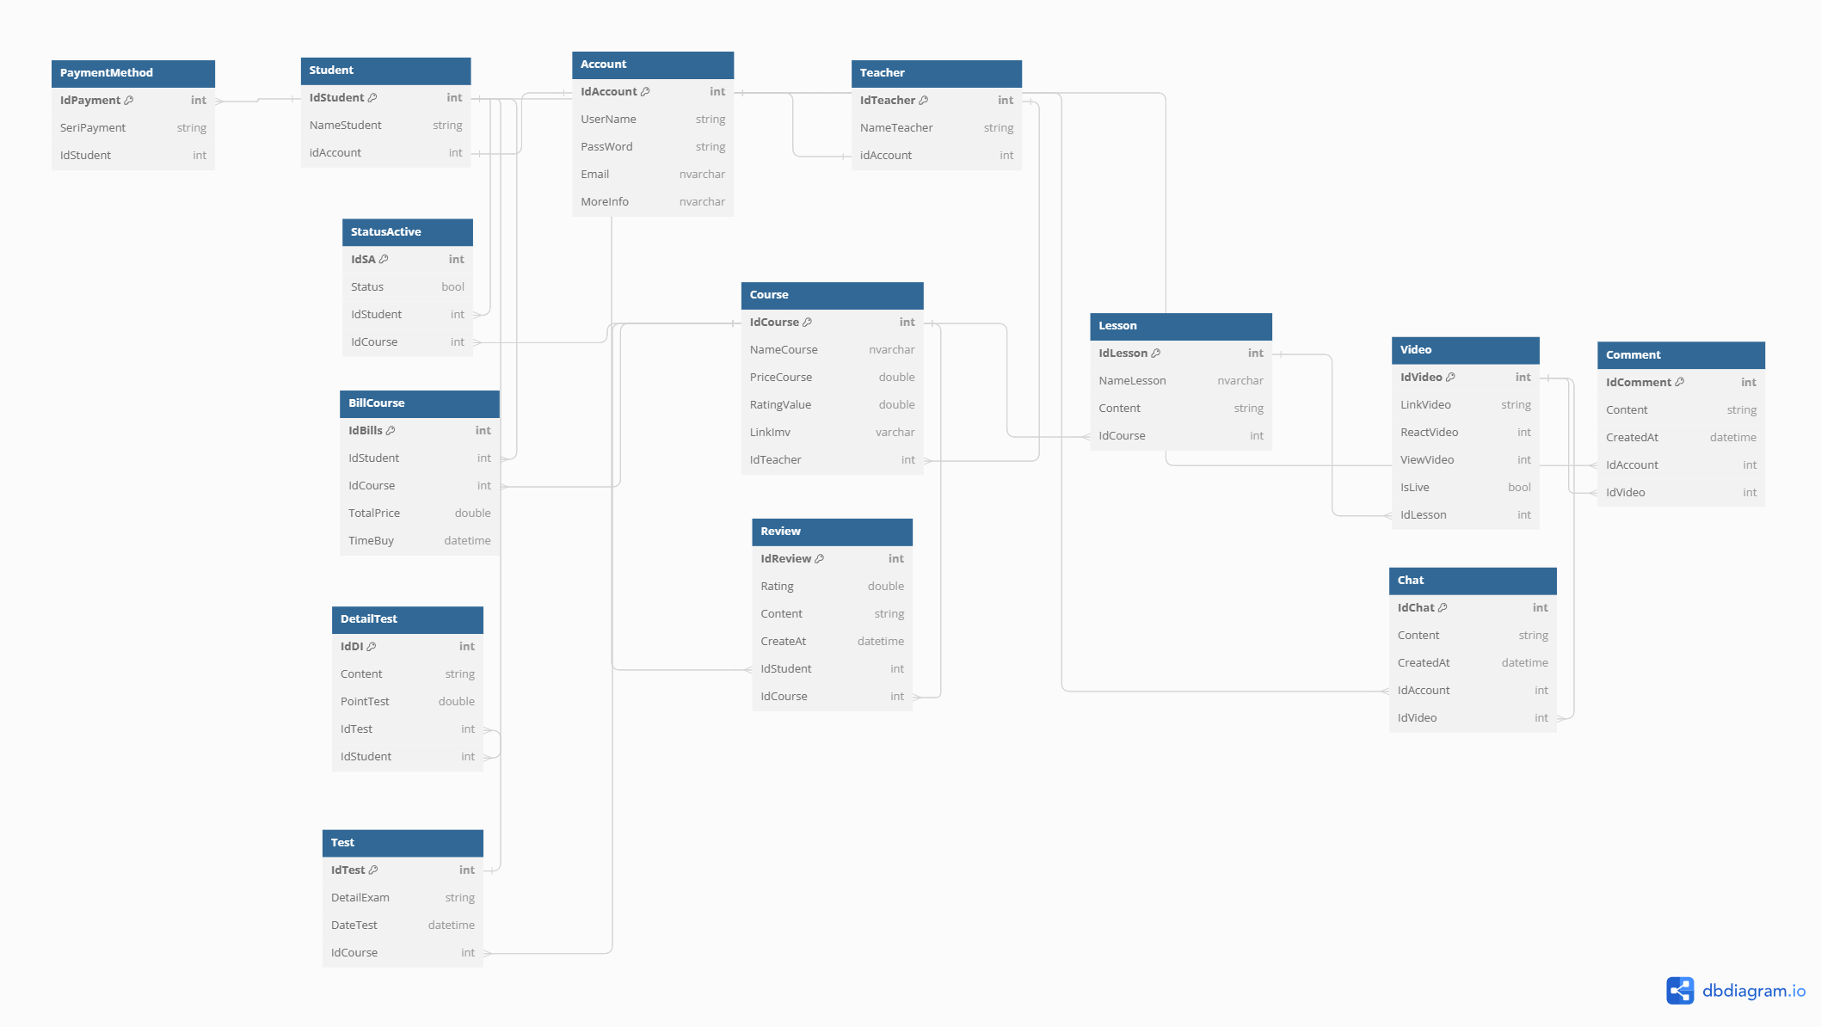

Slide 6
II. ANALYSIS
1. ANONYMOUS
2. USER
3. TEACHER
4. STUDENT

Slide 7


1. ANONYMOUS

Slide 8
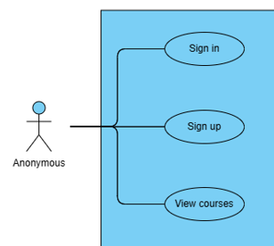

Slide 9
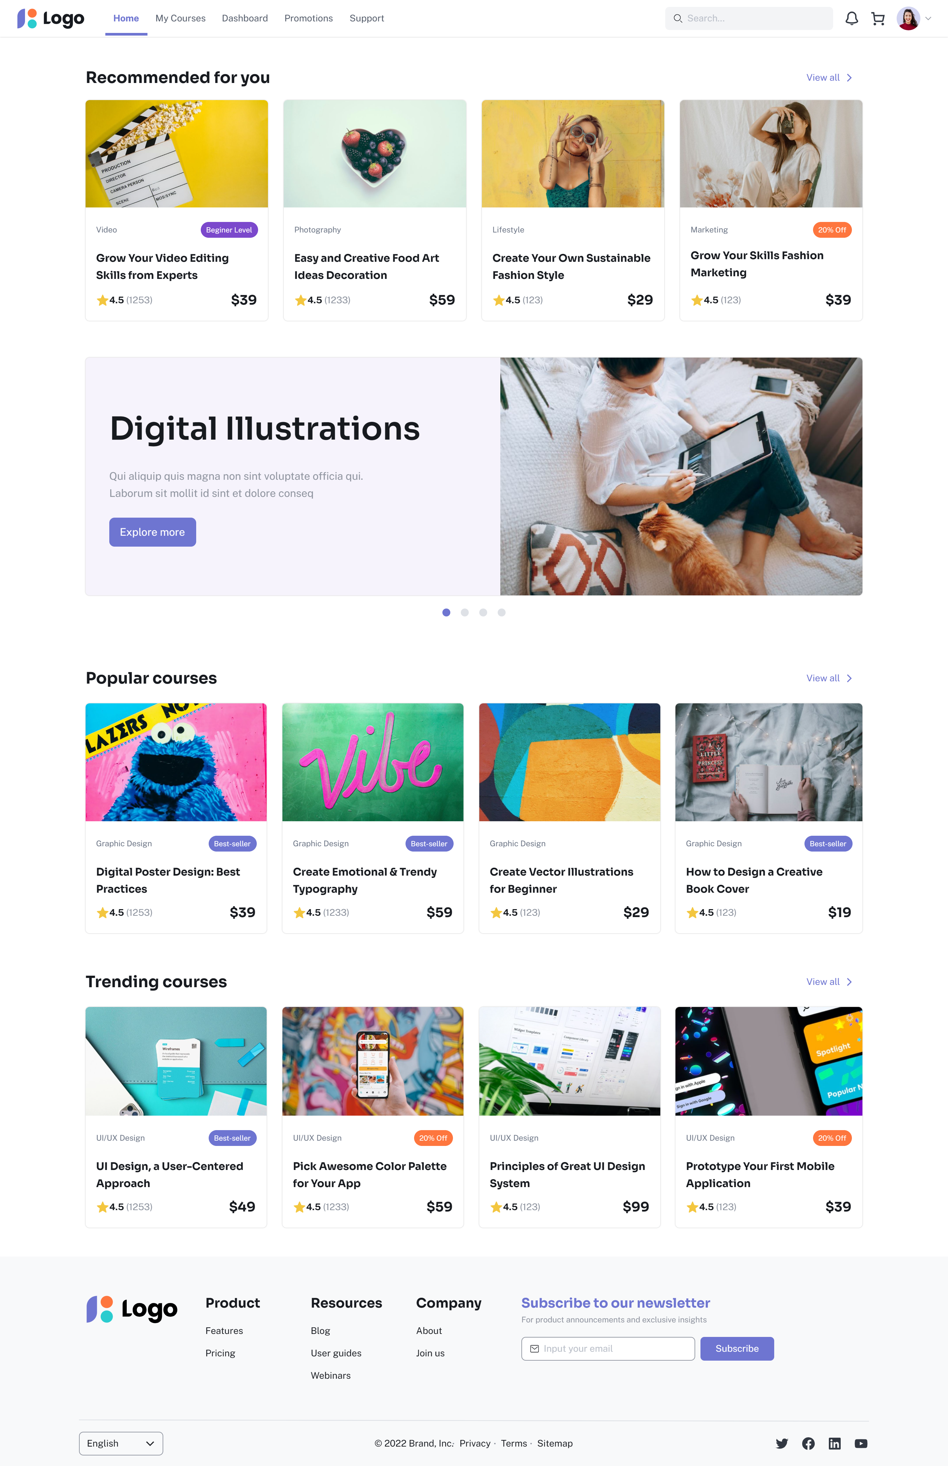
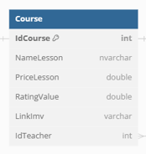
1. VIEW COURSE
SELECT c.NameLesson , c.PriceLesson, c.RatingValue
FROM Course c
WHERE RatingValue >4.4

Slide 10
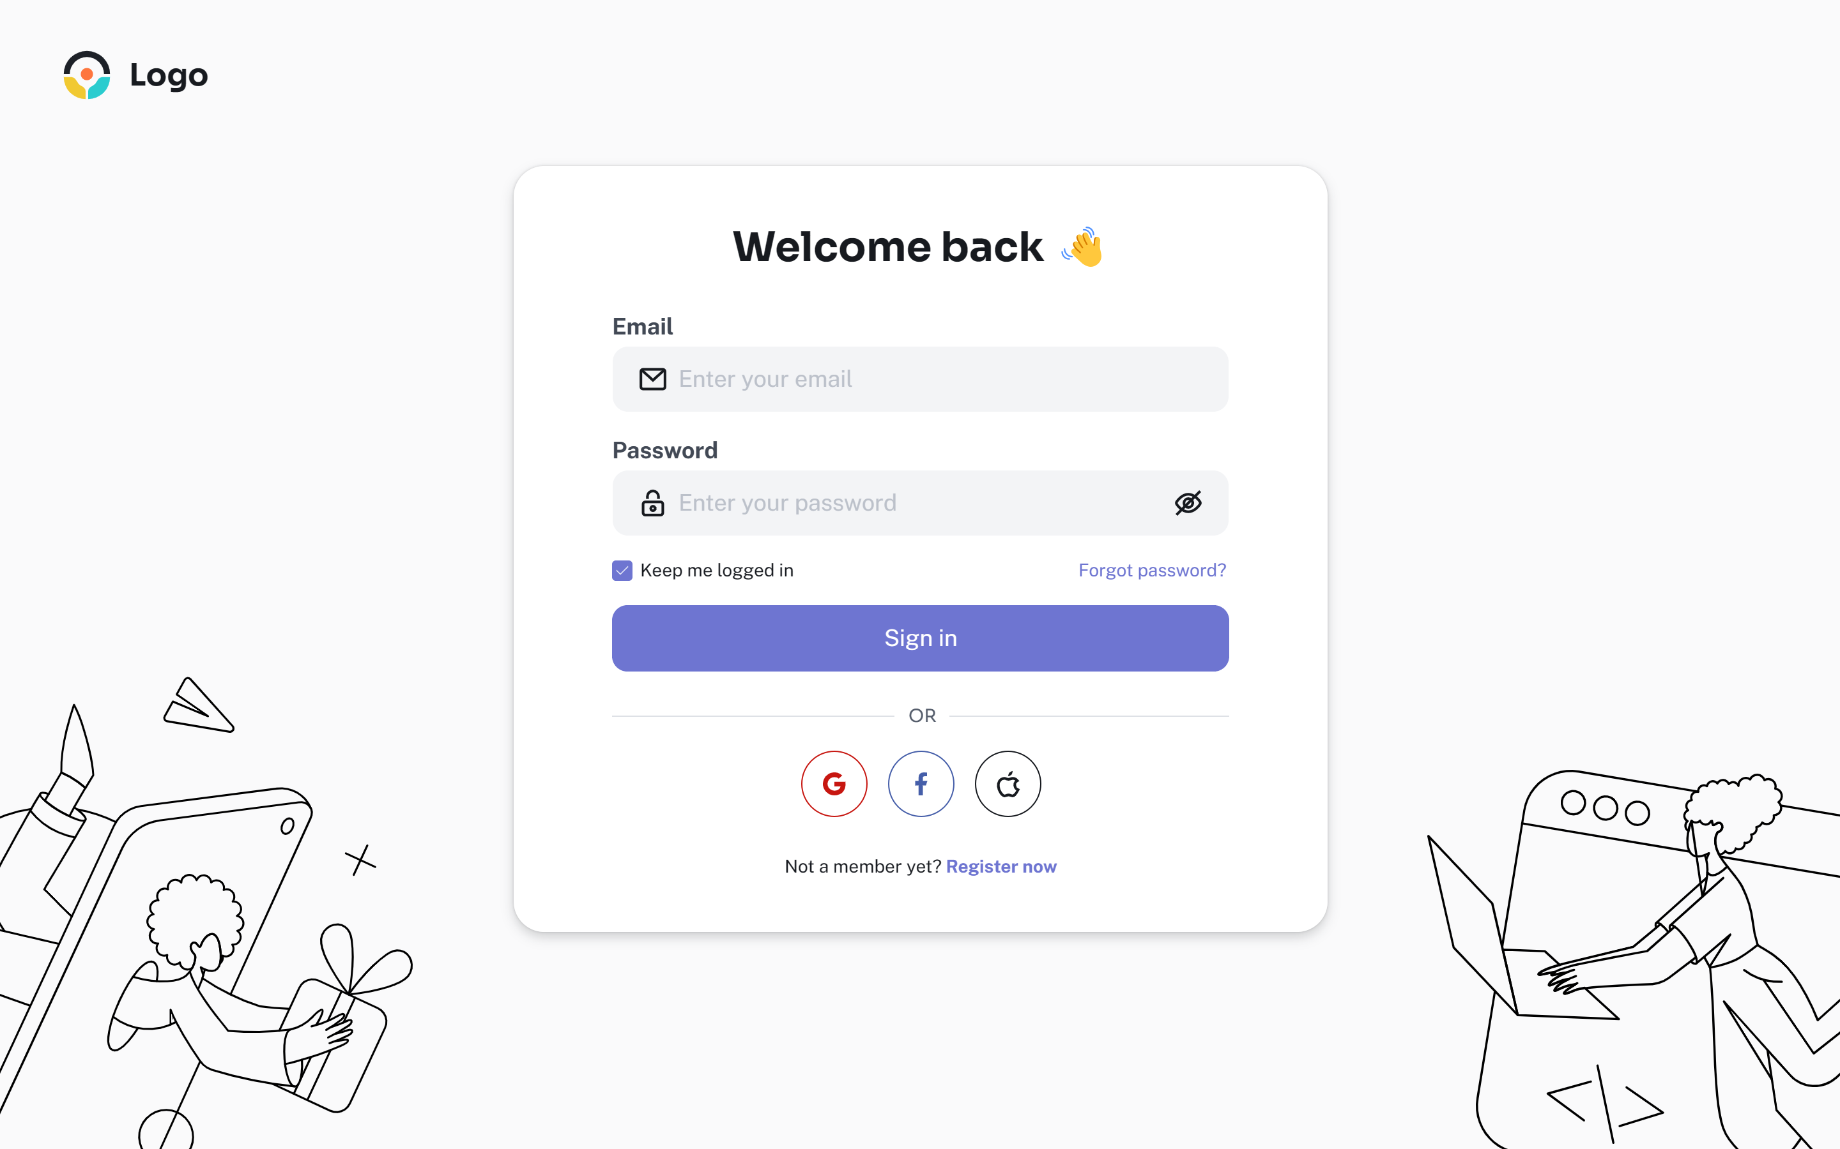
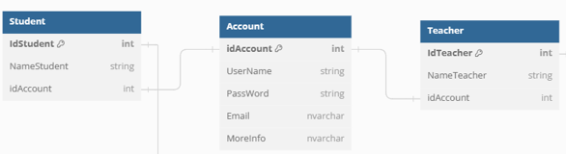
2. SIGN IN

Slide 11
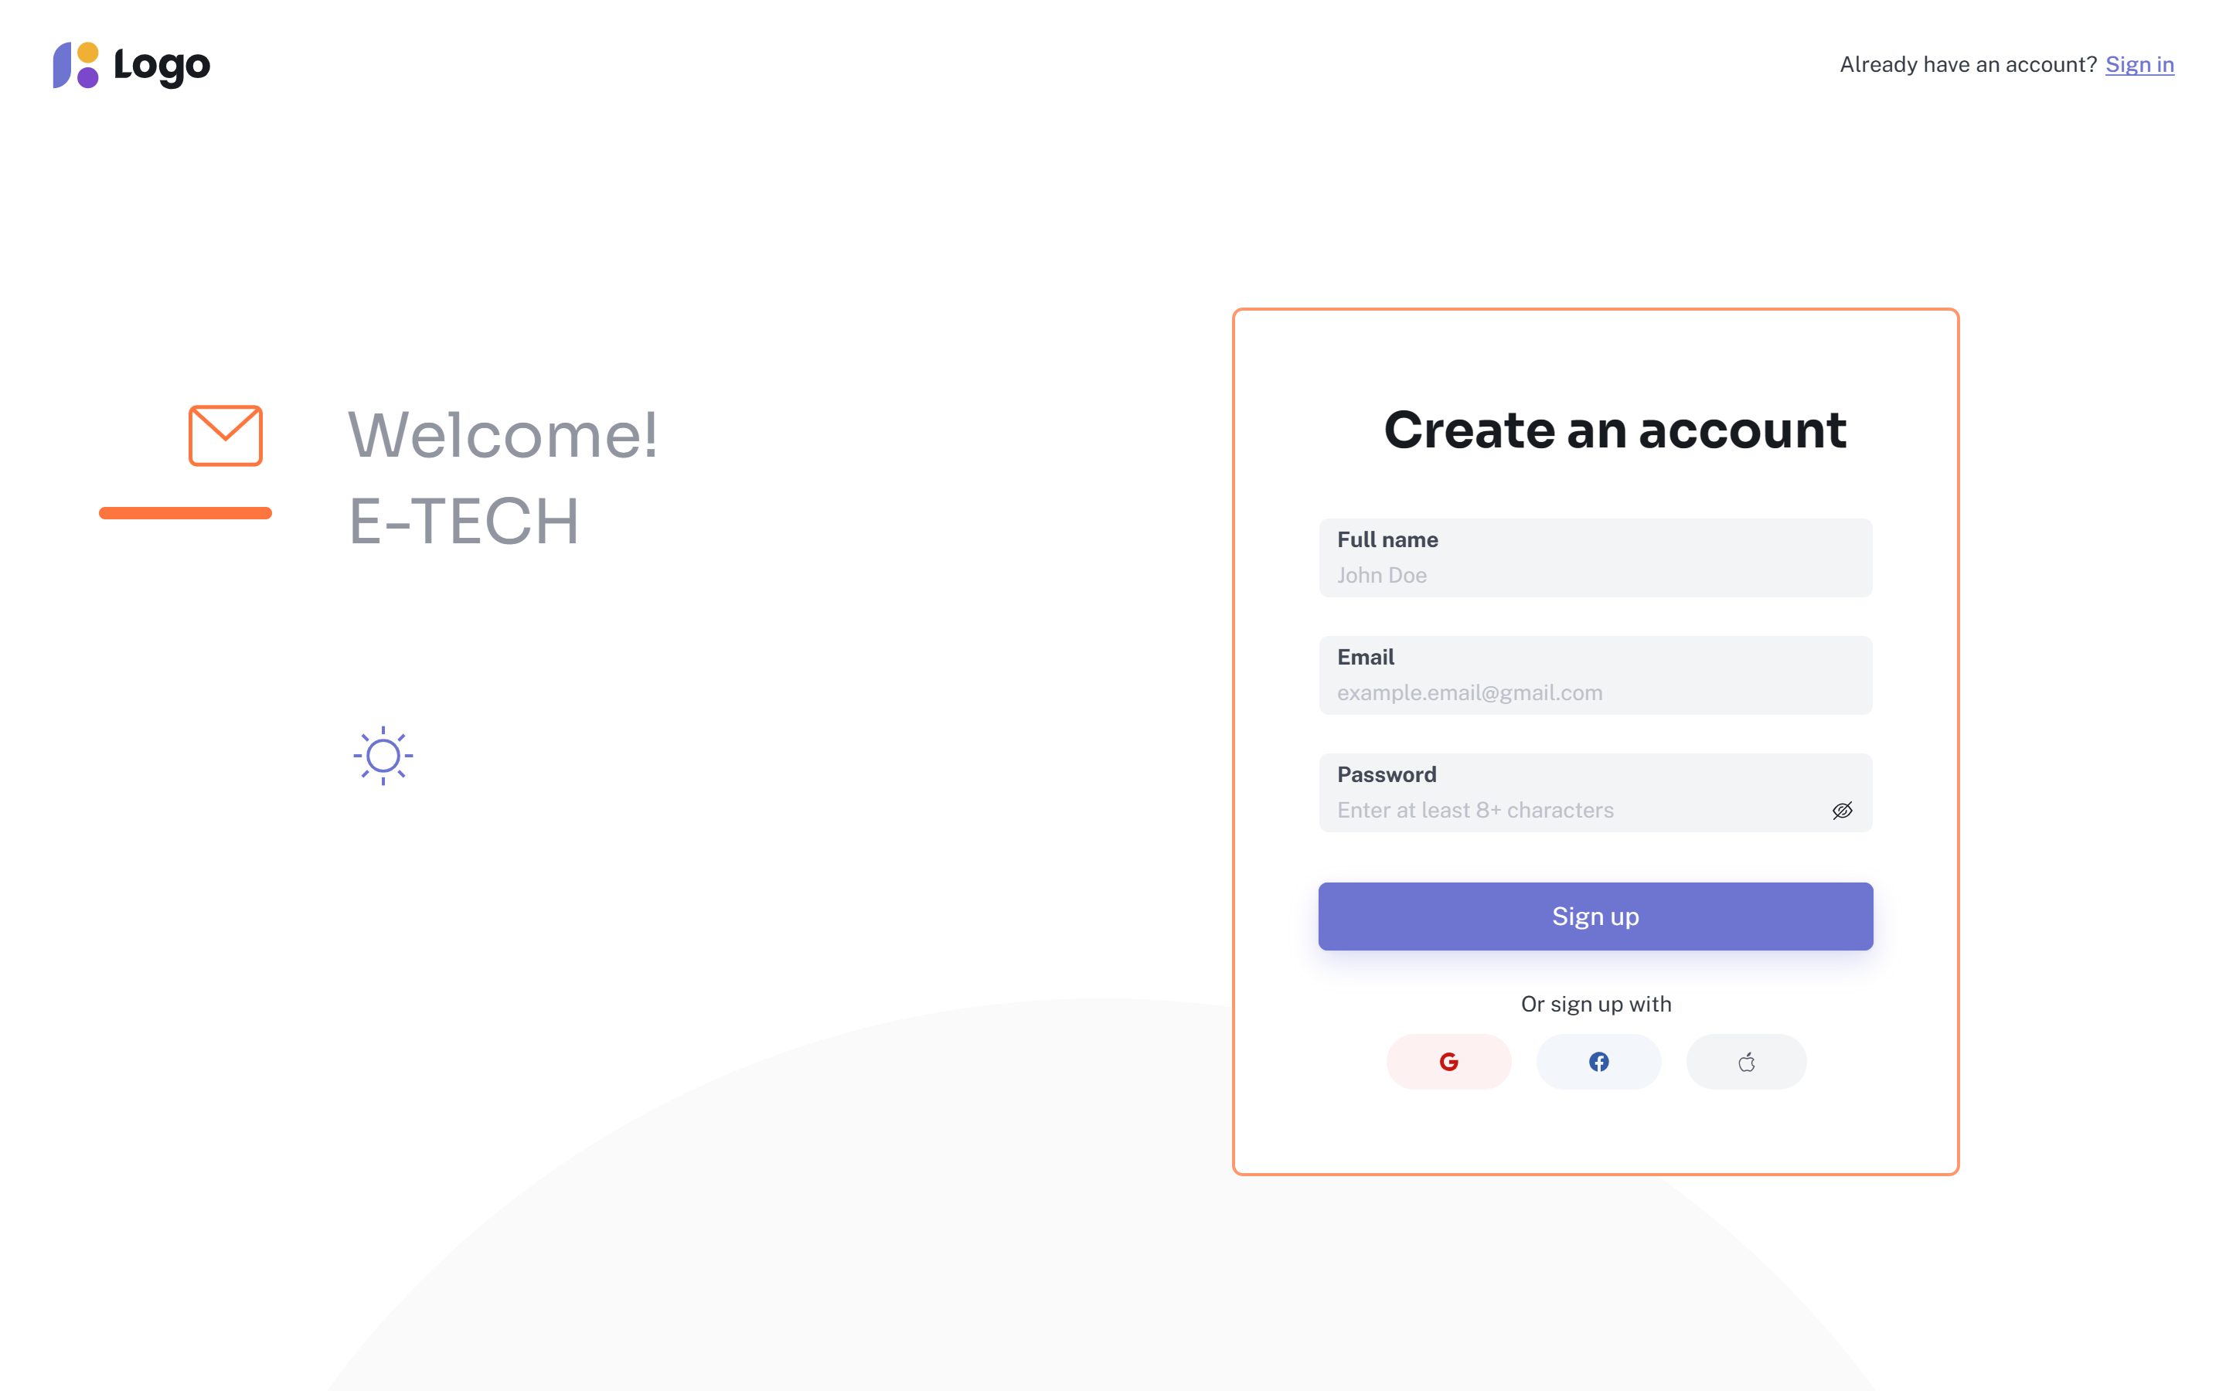
3. SIGN UP

Slide 12
2. USER

Slide 13
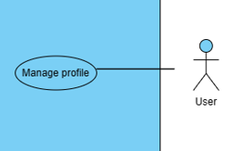

Slide 14
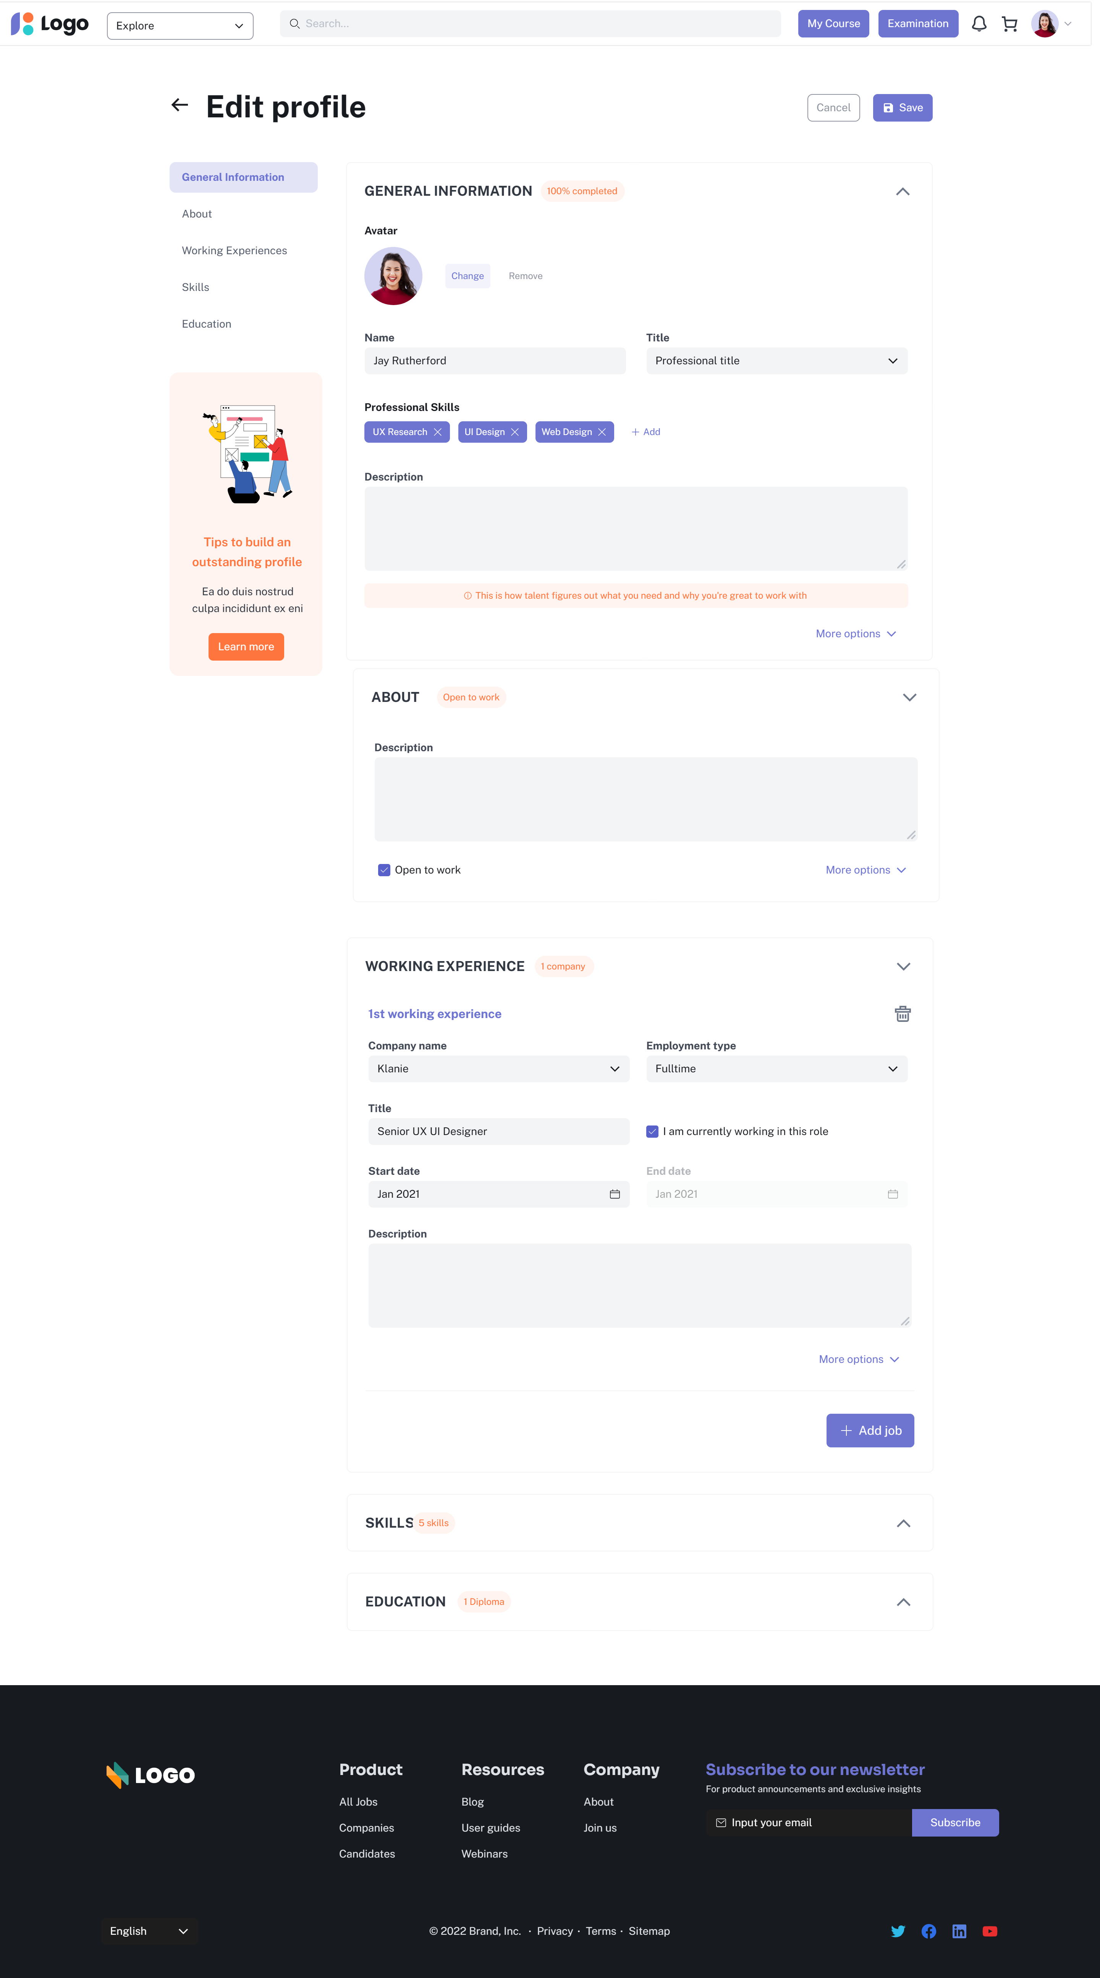
1. MANAGER PROFILE
SELECT acc.UserName, acc.PassWord, acc.Email, acc.MoreInfo
FROM Account acc

Slide 15
3. TEACHER

Slide 16
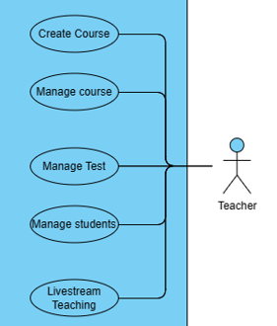

Slide 17
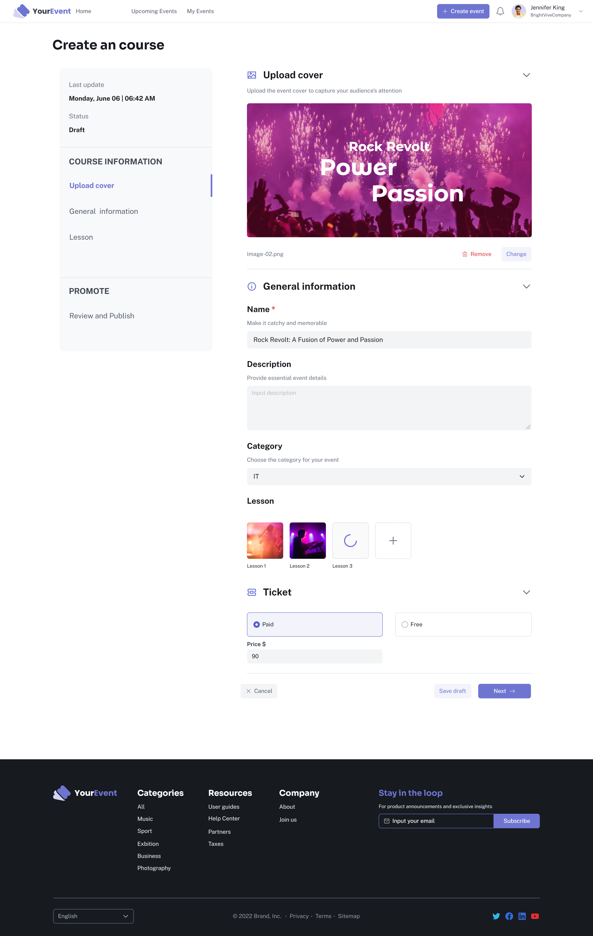
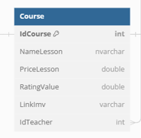
1. CREATE COURSE

Slide 18
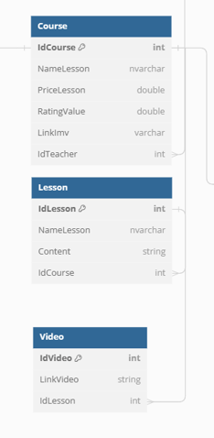
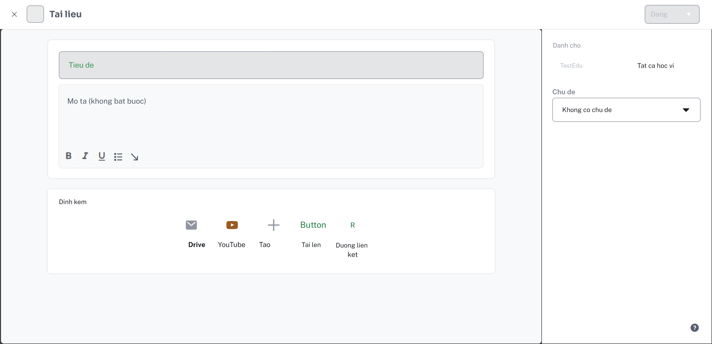
2. MANAGE COURSE

Slide 19
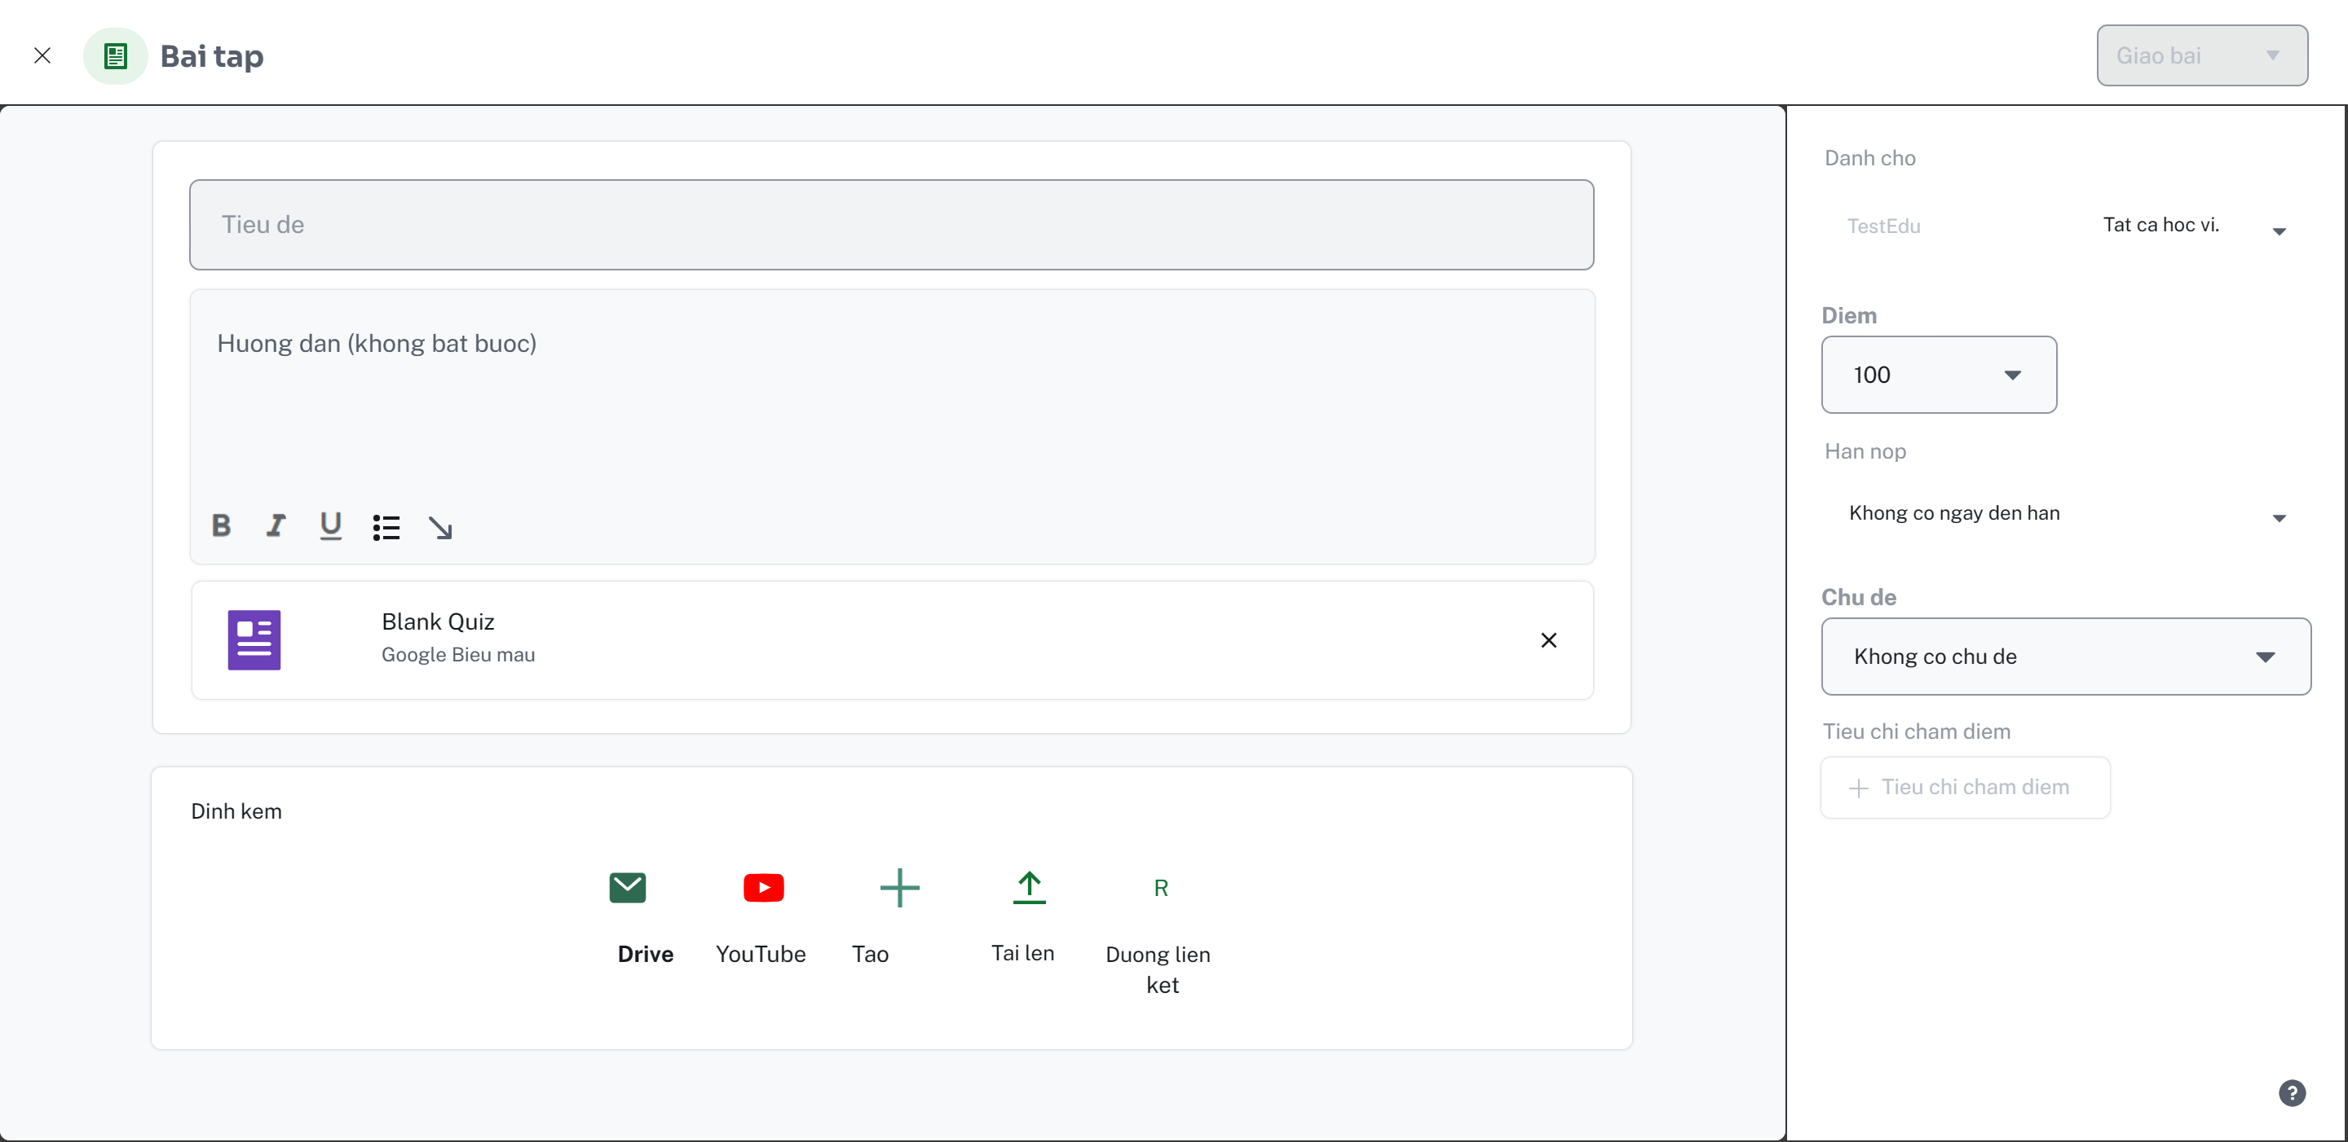
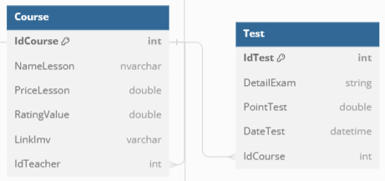
3. MANAGE TEST

Slide 20
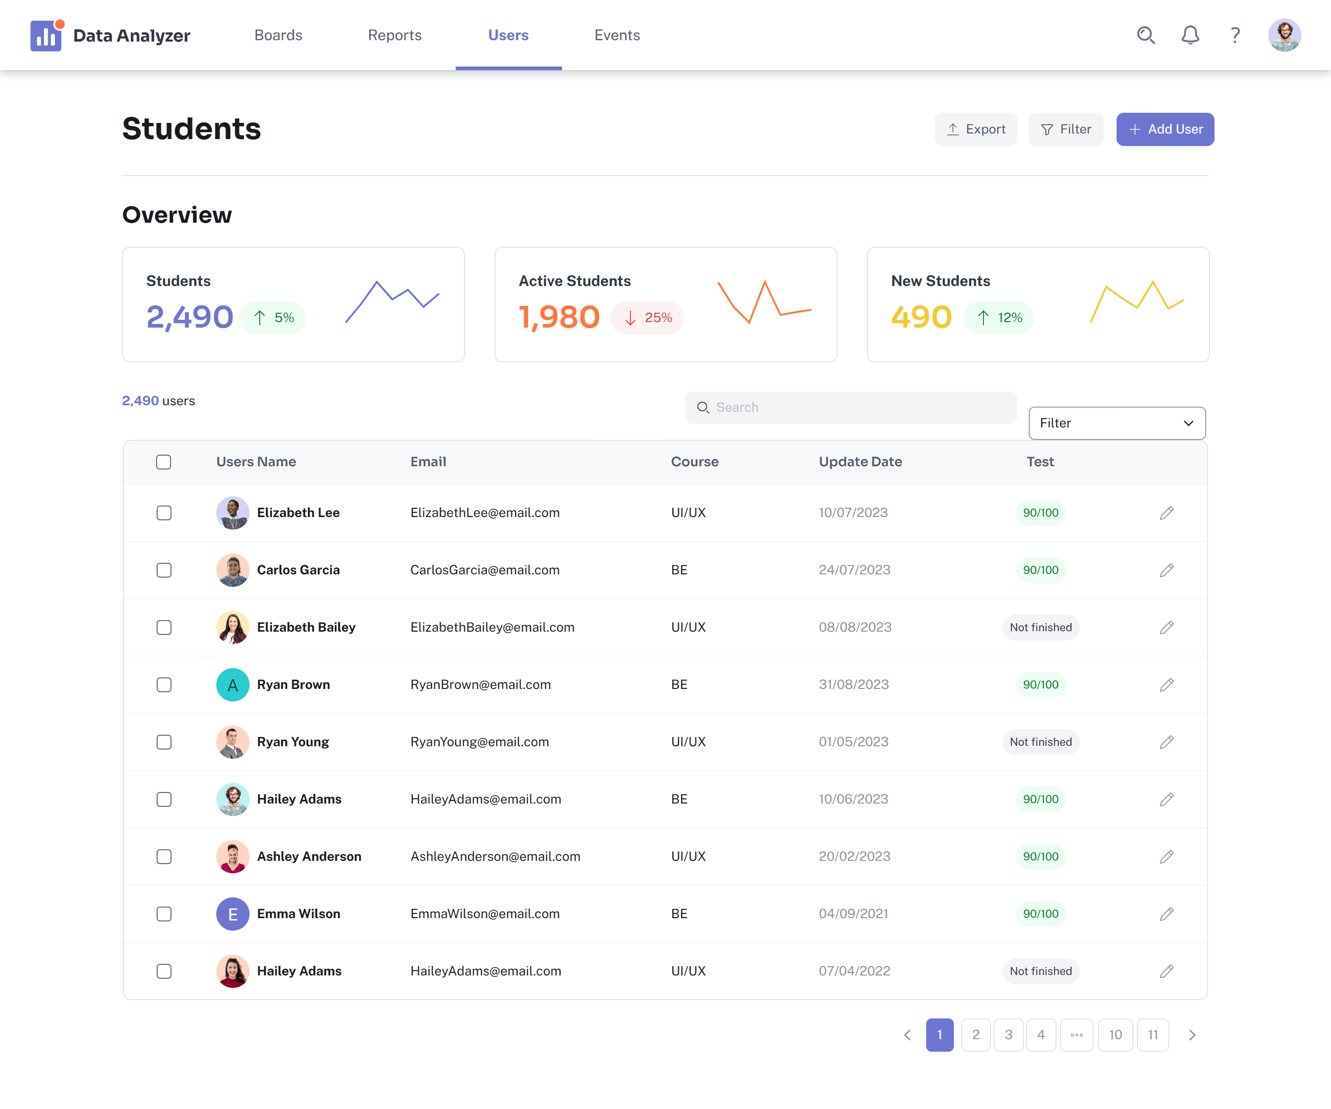
4. MANAGE STUDENT

Slide 21
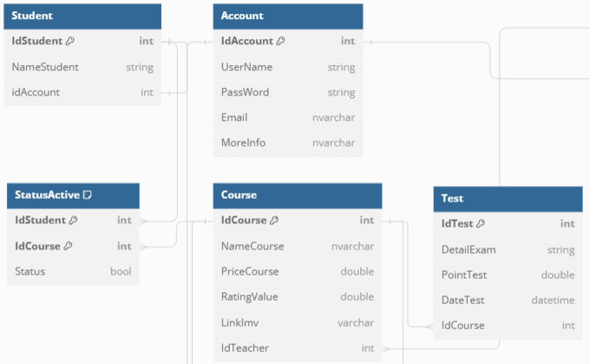
4. MANAGE STUDENT
SELECT s.NameStudent, a.Email, c.NameCourse,sa.Status ,t.PointTest
FROM Student s
Join Account a on a.IdAccount = s.IdAccount
Join StatusActive sa on sa.IdStudent=s.IdStudent
Join Course c on c.IdCourse=sa.IdCourse
Join Test t on t.IdCourse=c.IdCourse

Slide 22
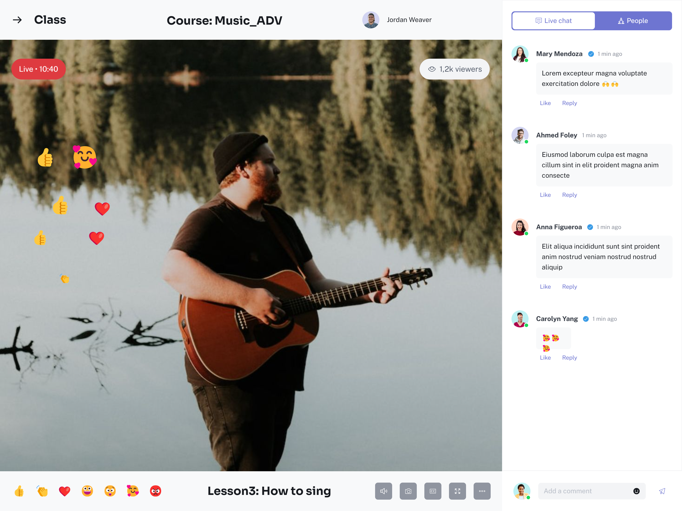
5. LIVESTREAM TEACHING

Slide 23
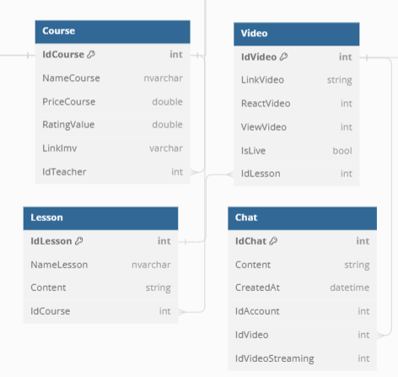
5. LIVESTREAM TEACHING
SELECT s.NameCourse, l.NameLesson, v.LinkVideo, v.ReactVideo, v.ViewVideo
FROM Course s
Join Lesson l.IdCourse = s.IdCourse
Join Video v on v.IdLesson=l.IdLesson

Slide 24
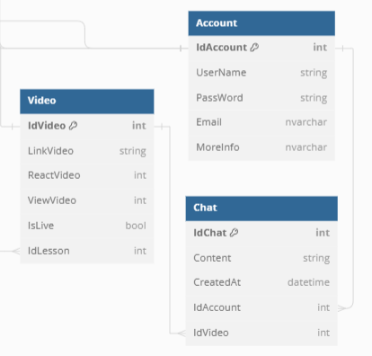
5. LIVESTREAM TEACHING
SELECT a.Username, c.Content, c.CreatedAt
FROM Video v
Join Chat c on c.IdVideo = v.IdVideo
Join Account a on a.Account=c.IdAccount
WHERE v.IsLive=true

Slide 25
4. Student

Slide 26
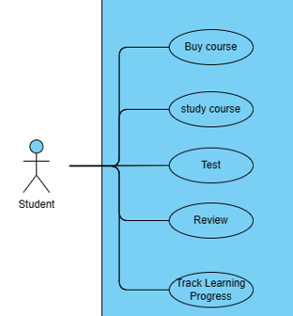

Slide 27
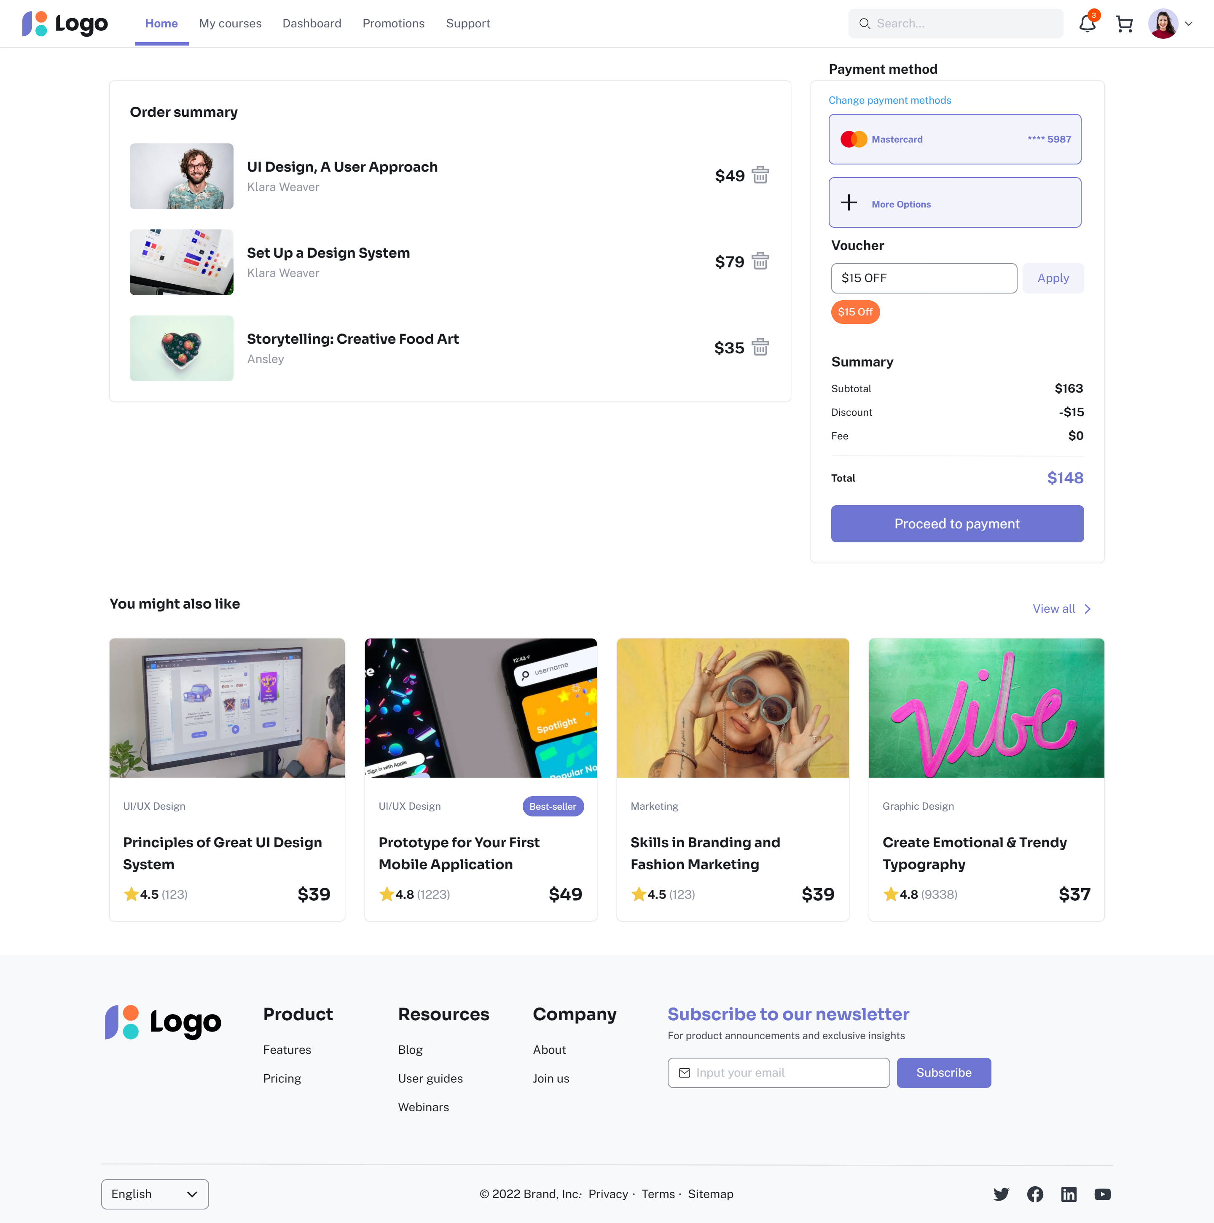
1. BUY COURSE

Slide 28
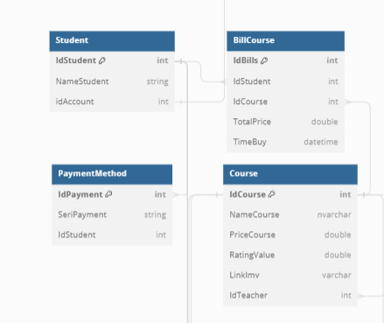
1. BUY COURSE
SELECT c.NameCourse, c.PriceCourse, pm.IdPayment, pm.SeriPayment, bcTotalPrice
FROM Student s
Join PaymentMethod pm on pm.IdStudent on s.IdStudent
Join BillCourse bc on bc.IdStudent=s.IdStudent
Join Course c on c.IdCourse=bc.IdCourse

Slide 29

2. STUDY COURSE

Slide 30
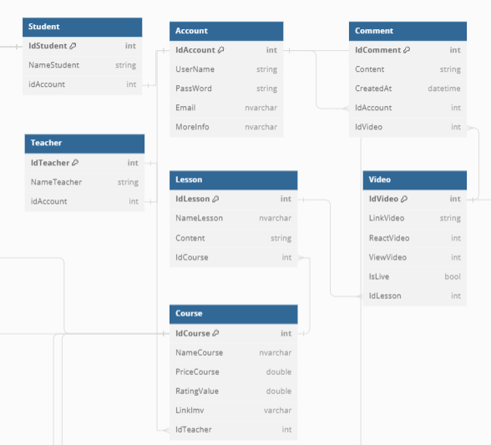
2. STUDY COURSE
SELECT c.NameCourse , l.NameLesson, l.Content, v.LinkVideo, v.ReactVideo, v.ViewVideo, s.NameStudent, t.NameTeacher, cm.Content, cm.CreatedAt
FROM Course c
Join Lesson l on l.IdCourse=c.IdCourse
Join Video v on v.IdLesson=l.IdLesson
Join Comment cm on cm.IdVideo = v.IdVideo
Join Account a on a.IdAccount = cm.IdAccount
Join Student s on s.IdAccount = a.IdAccount
Join Teacher t on t.IdAccount = s.IdAccount

Slide 31
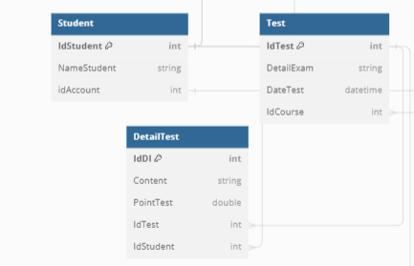
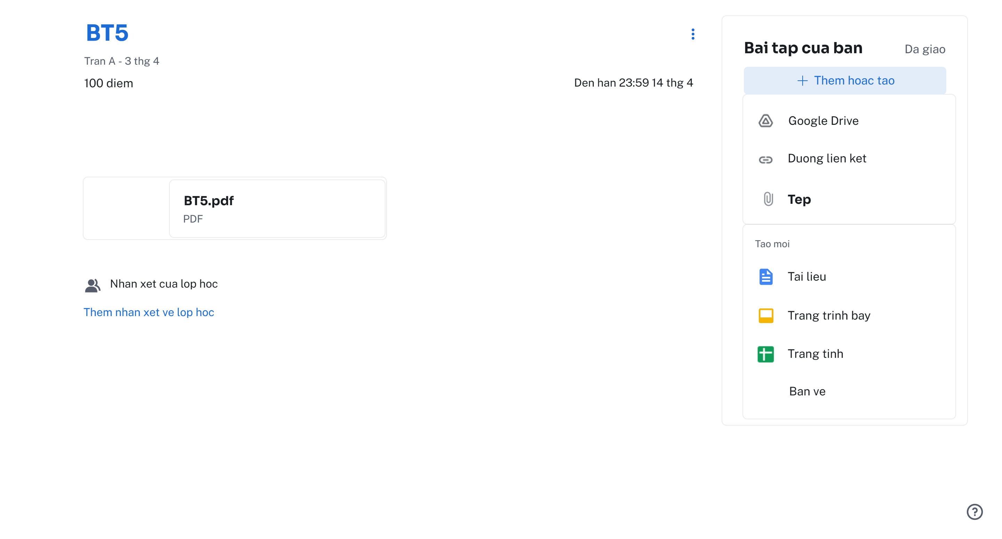
3. TEST

Slide 32
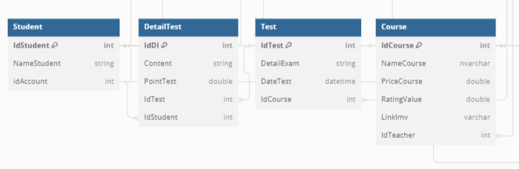
3. TEST
SELECT c.Namecourse, t.DetailExam, t.DateTest. dt.Content
FROM Student s
Join DetailTest dt on dt.IdStudent=s.IdStudent
Join Test t on t.IdTest = dt.IdTest
Join Course c on c.IdCourse = t.IdCourse

Slide 33
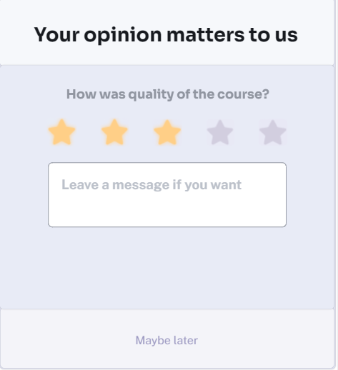
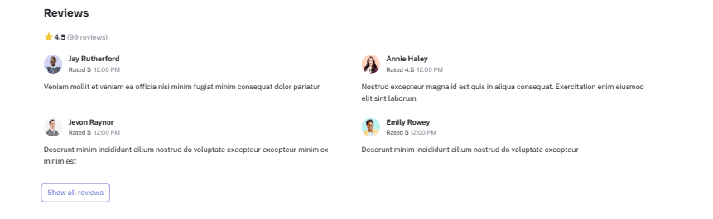
4. REVIEW

Slide 34
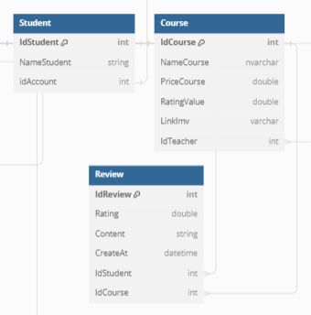
4. REVIEW
SELECT s.NameStudent, r.Content, r.Rating, r.CreateAt
FROM Student s
Join Review r on r.IdStudent=s.IdStudent
Join Course c on c.IdCourse = r.IdCourse

Slide 35
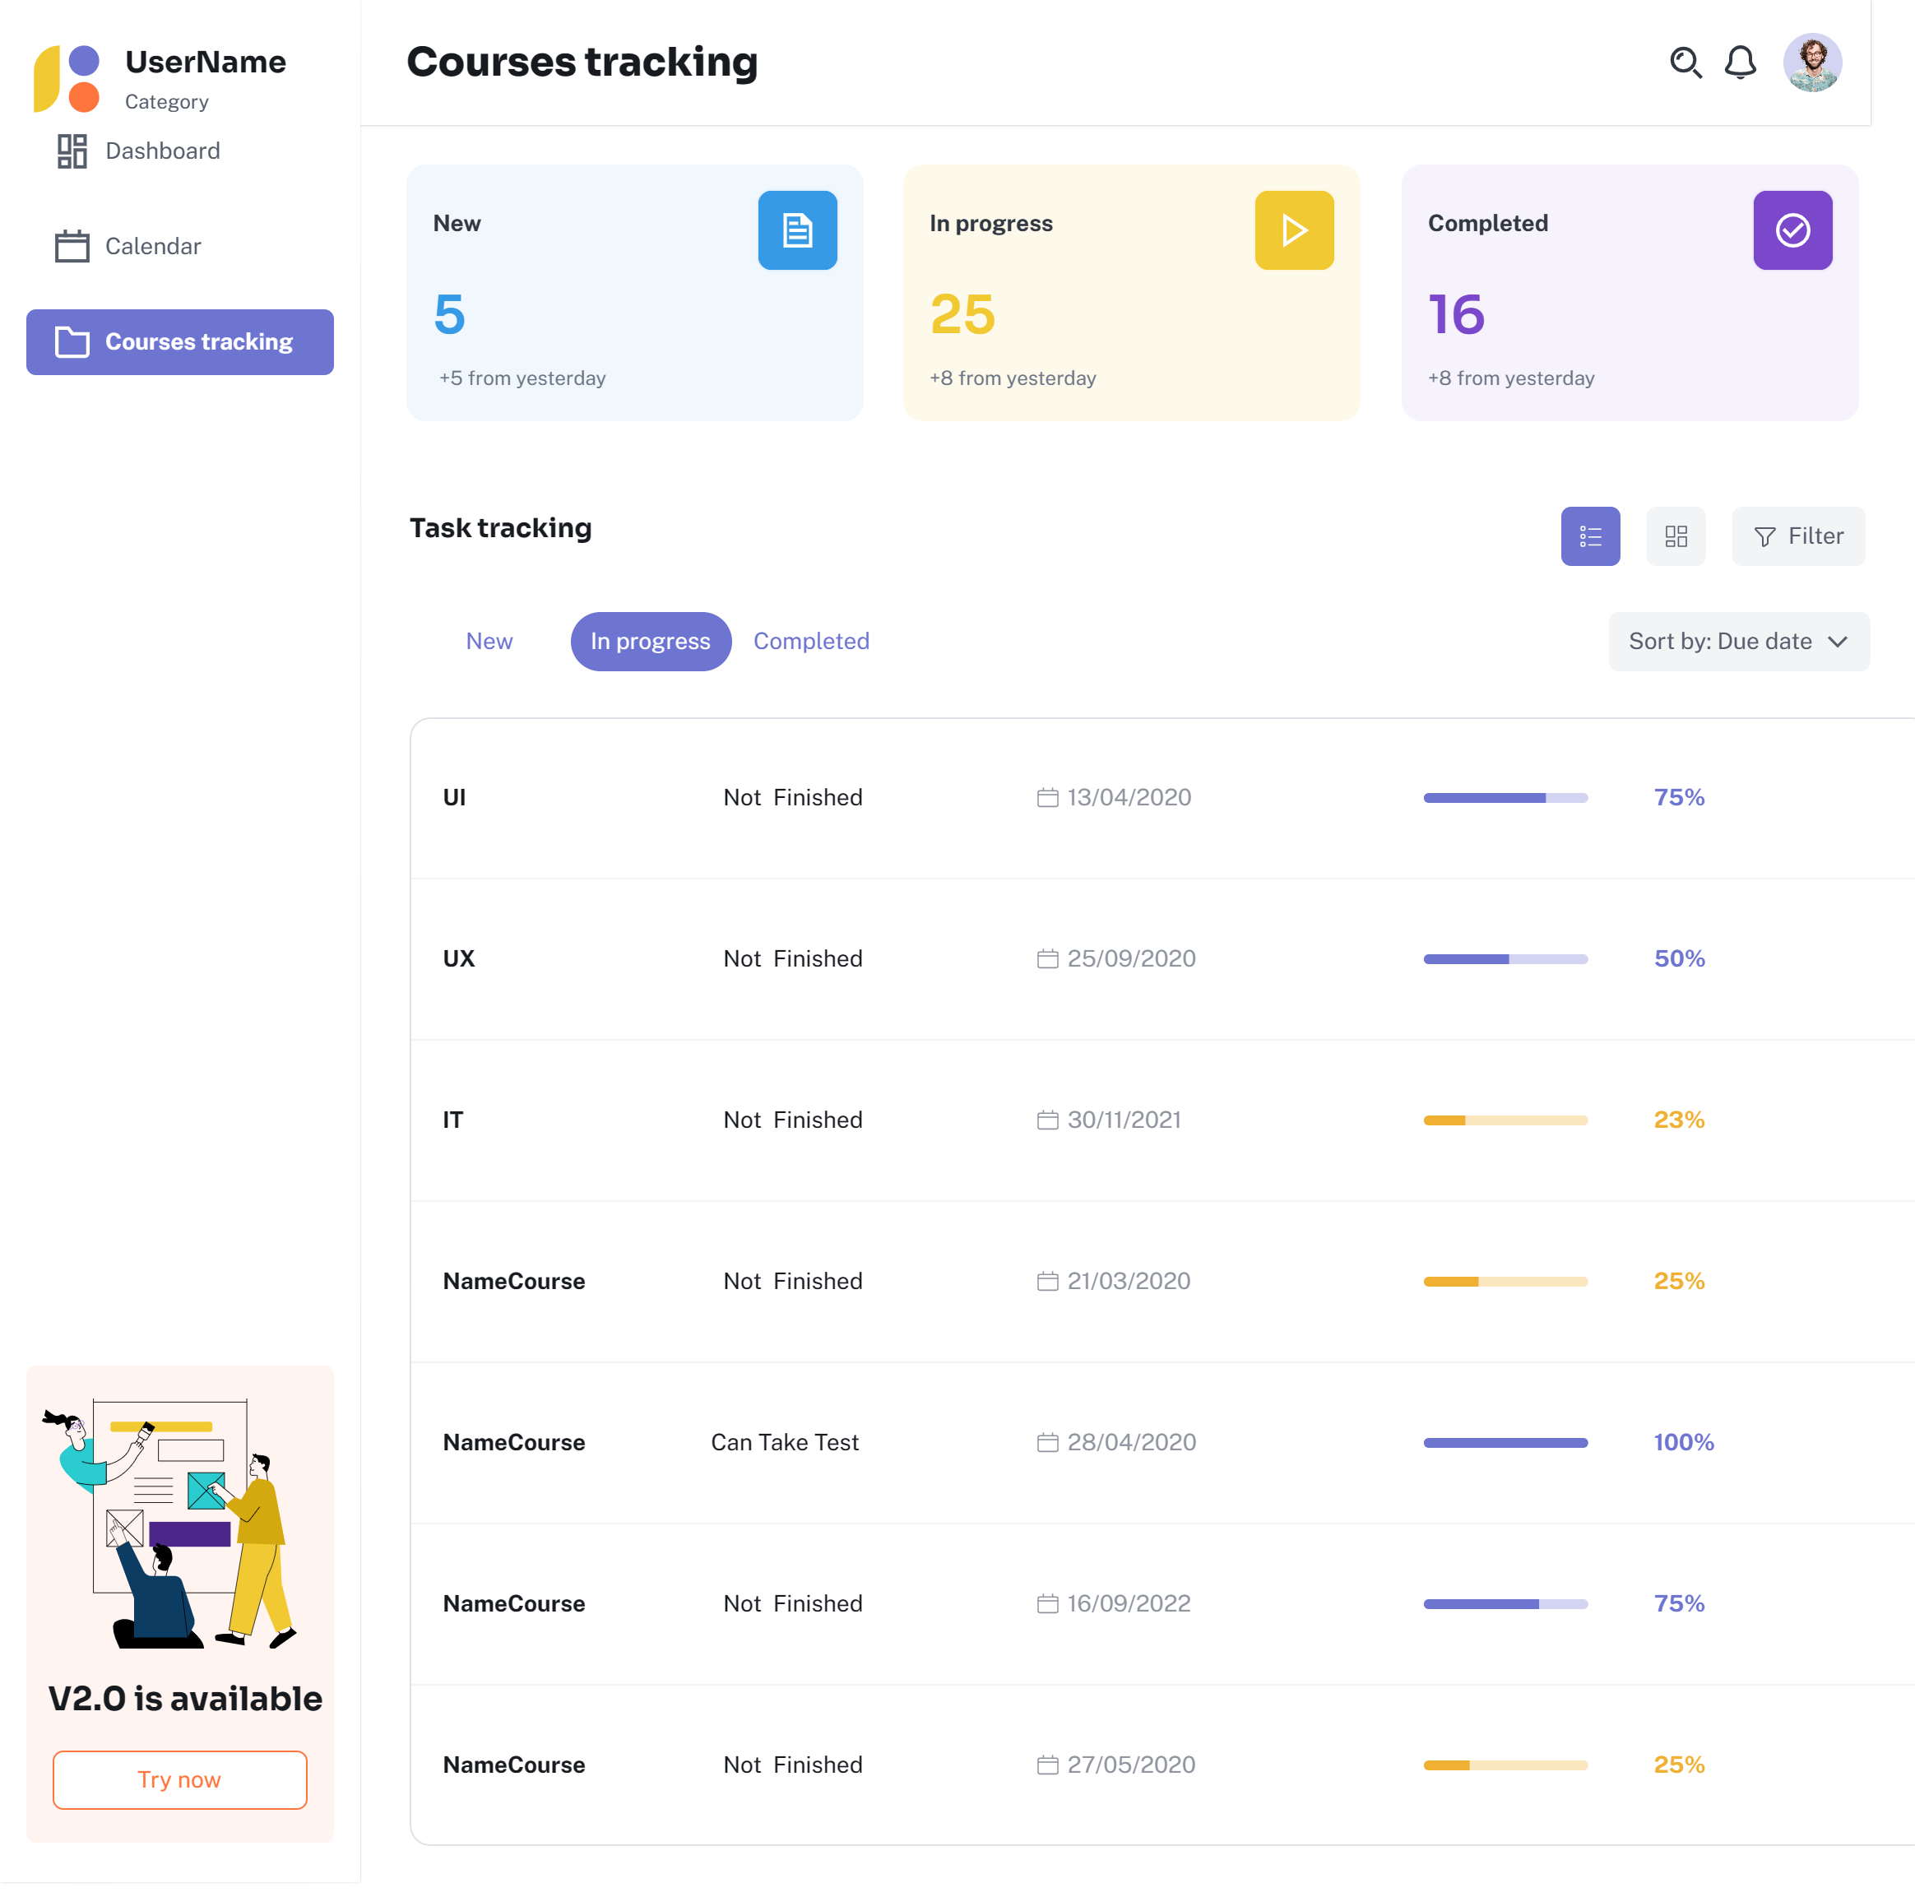
5. TRACK
LEARNING PROGRESS

Slide 36
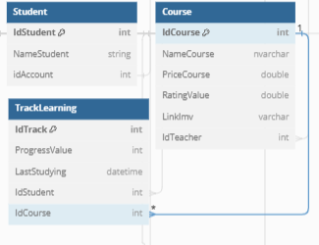
5. TRACK
LEARNING PROGRESS
SELECT c.NameCourse, tl.ProgressValue, tl.LastStudying
FROM Student s
Join TrackLearning tl on tl.IdStudent=s.IdStudent
Join Course c on c.IdCourse = r.IdCourse

Slide 37
THANKS FOR READING

